Slide 1
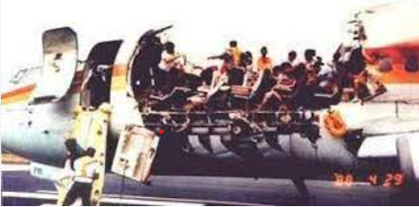
A Case Study in Material Failure
2011049
2011050
2011051
2011052
2011053
2011054
Understanding the catastrophic consequences of fatigue and Corrosion
Group - G7

Slide 2
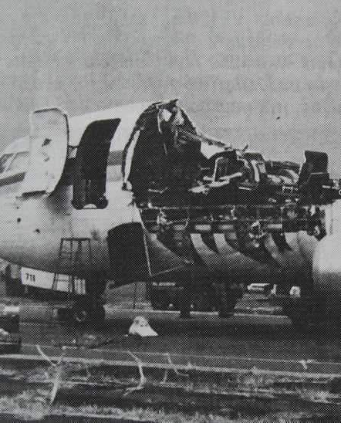
Case:
Aloha Airlines Flight 243 was a scheduled Aloha Airlines flight between Hilo and Honolulu in Hawaii. On April 28, 1988, a Boeing 737-297 serving the flight suffered extensive damage. While the aircraft was climbing to cruising altitude, the separation of 18 feet of the cabin skin, structure aft of the cabin entrance door, and above the passenger floor-line occured due to poor maintenance and metal fatigue.

Slide 3
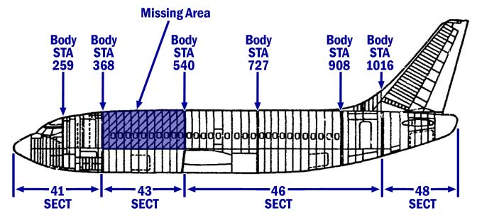
Casualties:
Number of deaths: 1
Injuries (nonfatal): 6

Slide 4
Investigation:
Safety Issues:
Poor quality of air carrier maintenance program and FAA surveillance
The engineering designs, certification and continuing airworthiness of the B-737 with particular emphasis on multiple site fatigue cracking of the fuselage lap joints
Human aspects of air carrier maintenance and inspection

Slide 5
Investigation:
Physical and chemical aspects:
In contact with corrosive environment in entirety of its service
Crevice corrosion occurring in between lap joints
Cylindrical shape of the airplane’s fuselage resulting in the larger longitudinal stress leading to the rapid decompression
Cold-bond usage in the lap joints which had low environmental durability and was susceptible to corrosion

Slide 6
Investigation(Contd.):
Physical and chemical aspects:
Corrosion accelerates the mechanism of fatigue failure by generating stress concentration
Repeated pressurization and depressurization cycles causing stress on the fuselage leading to metal fatigue
Multiple site fatigue cracking of the skin adjacent to lap joints of upper rivet row
Weakened structural integrity of the aircraft

Slide 7
Investigation
Overview
The combination of corrosion weakening the metal structure the specific lap joints and fatigue from repeated pressurized cycles ultimately lead to the catastrophic failure of the fuselage mid flight The sudden rupture created a significant opening in the cabin roof, resulting in rapid decompression and endangering the lives of passengers and crew.

Slide 8
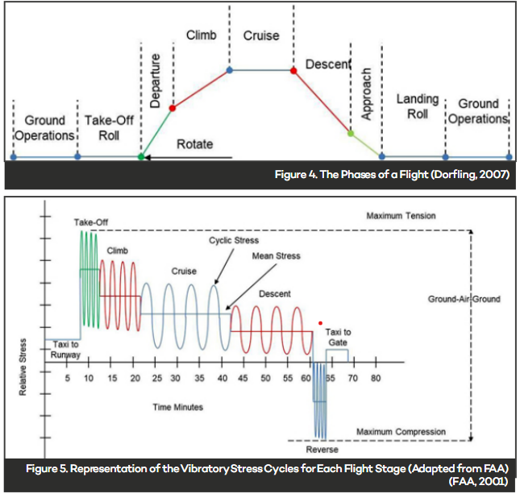
Mechanism:
Fatigue
Repeated loads and
random vibration results in fatigue fracture
failure

Slide 9
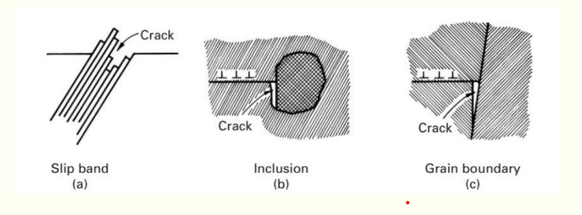
Mechanism:
Fatigue Crack Nucleation:
Source 1: Persistent Slip Bands (PSBs)
Source 2: Twin Boundaries
Source 3: Inclusions and second-phase particles
Source 4: Grain Boundaries
Source 5: Condition of Surface

Slide 10
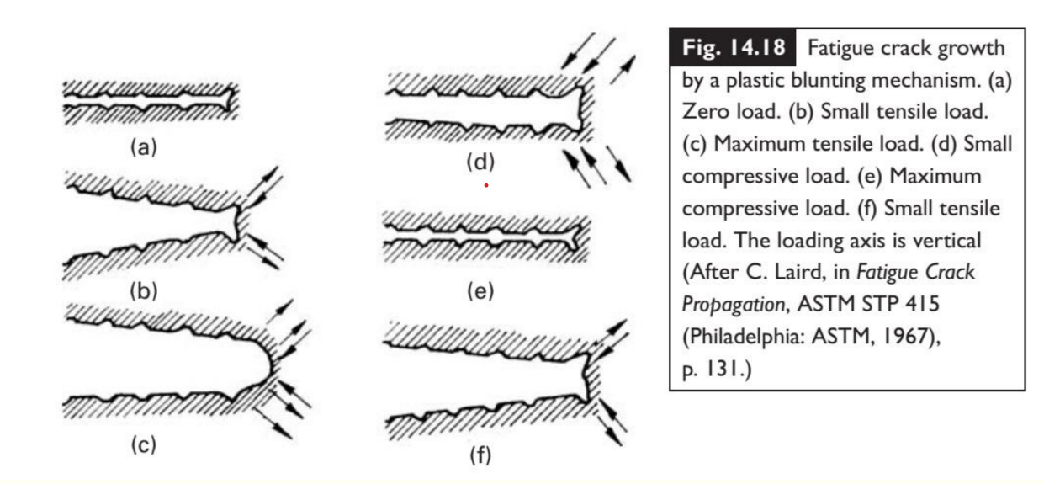
Mechanism:
Fatigue Crack Propagation:
Method 1: Fatigue crack growth by Striation Formation
Method 2: Fatigue crack growth by a plastic blunting mechanism

Slide 11
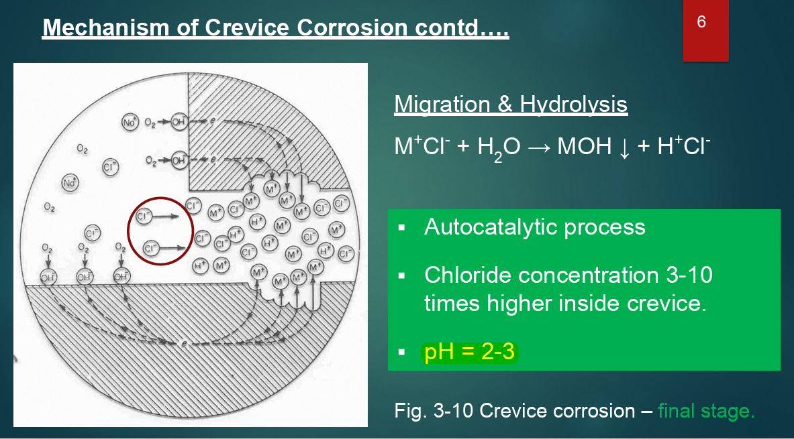
Mechanism:
Corrosion
Because of the plane flying above salty sea water the joint was attacked by crevice corrosion

Slide 12
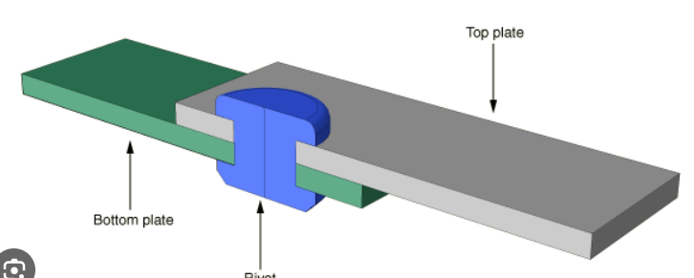
Remedies:
Implementing additional double sheet layer to
I) Eliminate knife edged fatigue which was due to disbonded upper skin
II)Eliminate crevice corrosion
Lap joint with rivet

Slide 13
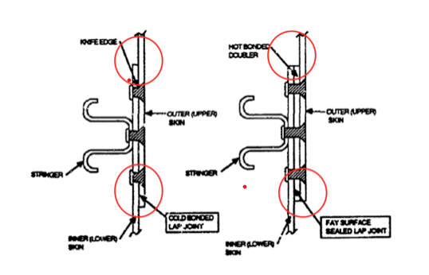
Remedies(contd.):
The lap joint samples collected from the aircraft was found having extensive fatigue cracking. The entire cold bonded lap joint was dis-bonded. So, instead of this hot bonded doubler can be used.

Slide 14
Preventions:
NDT testing
Proper fatigue life calculation using SN curve
Adjusting cycle loading cycles and stress
Shot peening at surface
Laser peening

Slide 15
References:
https://stonybrook.digication.com/weixiangfang/Additional_Material_and_Failure_Case_Study?fbclid=IwAR3sxmU-8Nw0yVB_i1HQLrFxvOYwroIkXM1cdqo2_C3PZSCeFDmTuduemHY
https://www.researchgate.net/publication/362731719_Fatigue_Studies_in_Aviation_in_Light_of_the_1988_Aloha_Airlines_Incident
https://master-dissertation.com/essays/case-studies/case-study-analysis-aloha-airlines-flight-243.html
https://www.ntsb.gov/investigations/AccidentReports/Reports/AAR8903.pdf?fbclid=IwAR2a6HdlCQ4iEvJYgDm7jXZv6z3OEYfFFi1SChmGCoD_rQLK9OydMjqWfXU
https://en.m.wikipedia.org/wiki/Aloha_Airlines_Flight_243?fbclid=IwAR1SVWs16TGiQ6DzN8rJ9-Ytwg5hZ45015F7sHQVhbf6D_O1EcZ9hxoT9N8

Slide 16
Thank You

